Slide 1


Bioinformatics service for gene co-expression analysis based on machine learning model
Вводная

Slide 2


Author
Pustoshilov Dmitriy Vasilievich
IKBO-04-16, 15&0327
Supervisor:
Candidate of Technical Sciences, Associate Professor of VT Department
O.V. Platonova
Economics consultant:
Ph.D. in Economics, Associate Professor
Grigorenko O.V.

Slide 3
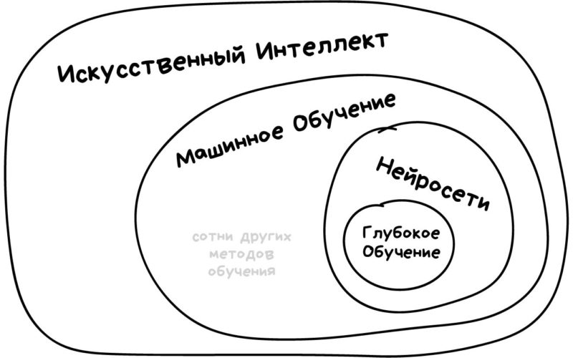
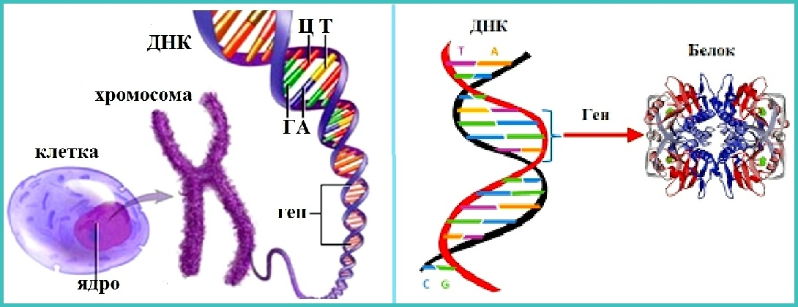
Terminology
SPPR
Machine learning
Data correlation
DNA
Genes
Gene expression
Co-expression of genes
3

Slide 4

Relevance
The Facts:
Slow integration of IT into science
Much inaccurate experimental data
Time between hypothesis advancement and testing
An interesting challenge: Co-expression of genes
Problem: The need for fast and up-to-date tools for visualizing gene correlations
4

Slide 5

The purpose and tasks
The purpose: To create a modern and easily accessible service that enables visualization of correlation analysis of gene expression data by machine learning algorithms using leased cloud computing power.
Tasks:
Explore the subject area
Choose the best tools and techniques
Implement machine learning algorithm
Create a prototype web application and implement it programmatically
Transfer all algorithms to a cloud service
5

Slide 6
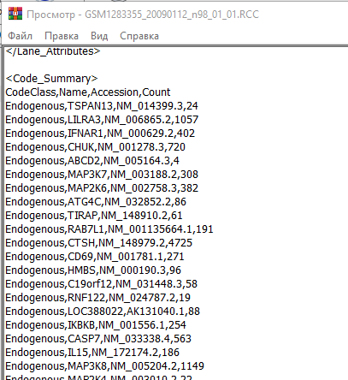
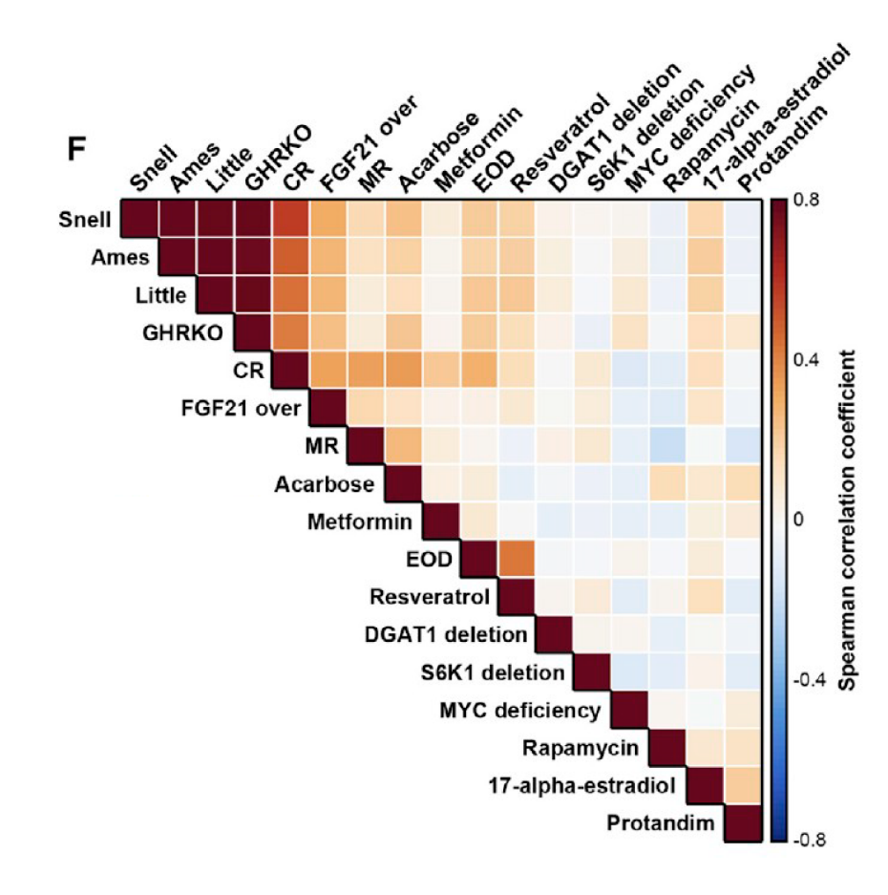
Data
Input
Output
6

Slide 7
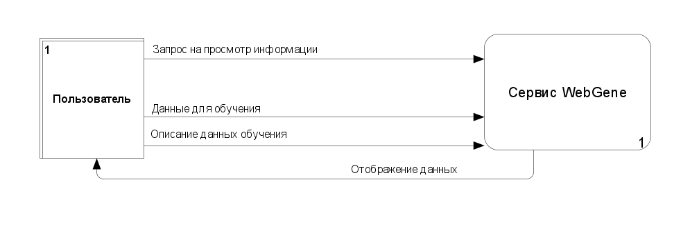
System structure
Methodology DFD
Tool: Ramus
7

Slide 8
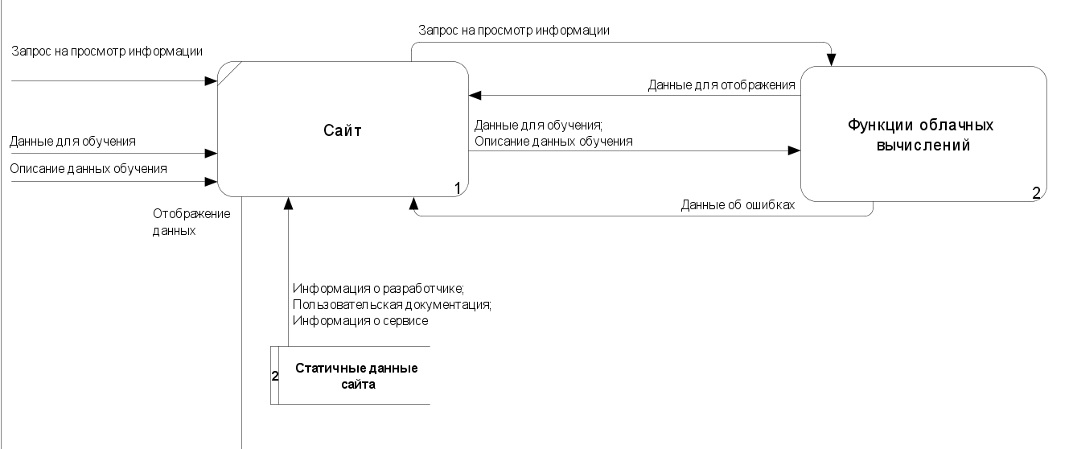
System structure
8

Slide 9
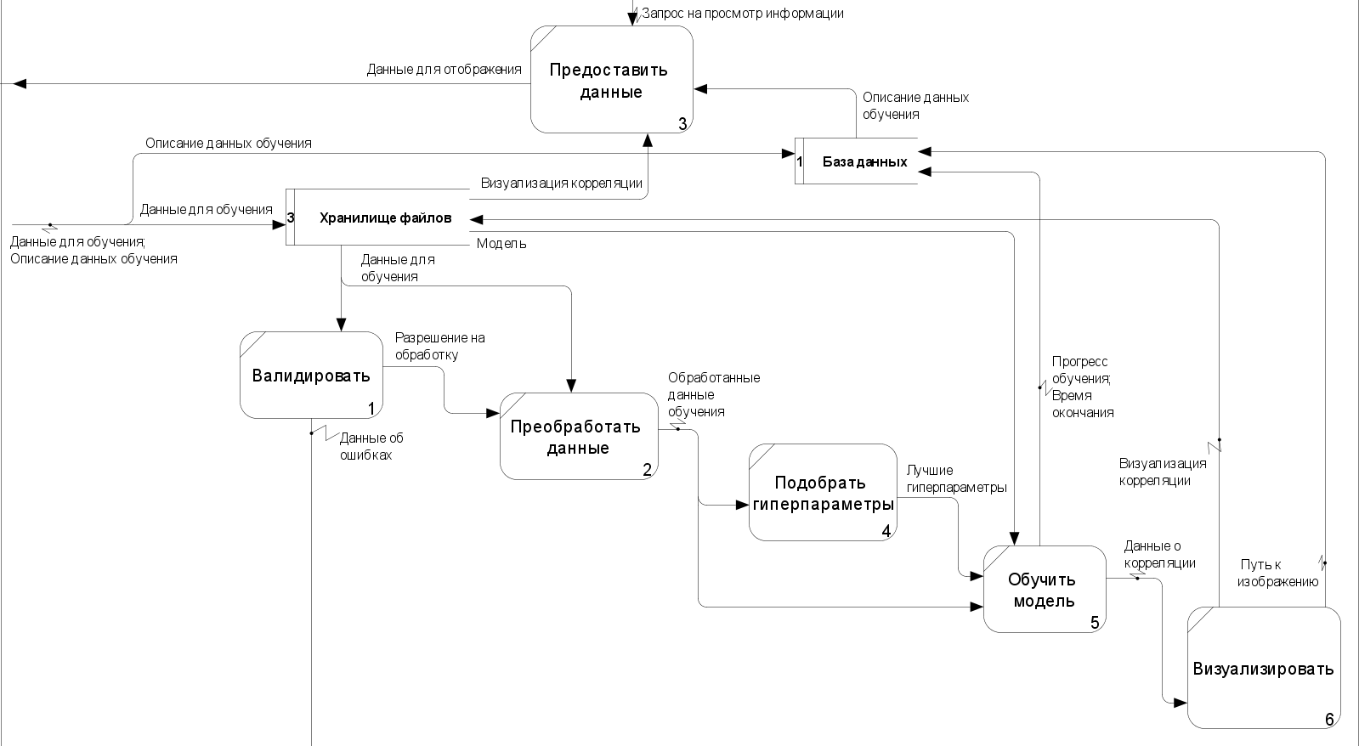
System structure
9

Slide 10

Tools and methods
Design methodology: Agile
Designing: Ramus, Draw.oi
Client-side: JS, React, Bootstrap
Site prototyping: Figma, Adobe illustrator
Site hosting: Google Cloud Platform
Repository: GitHub
Server-side: Python, Django, keras, scikit-learn
Machine Learning Algorithm: Random Forest
Visualizing: Tableue, seaborn, pandas, numpy
Data Base: PostgreSQL, pgAdmin
10

Slide 11
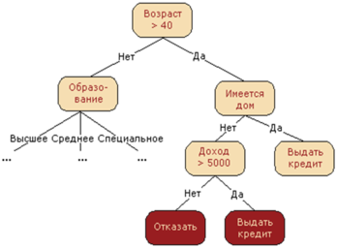
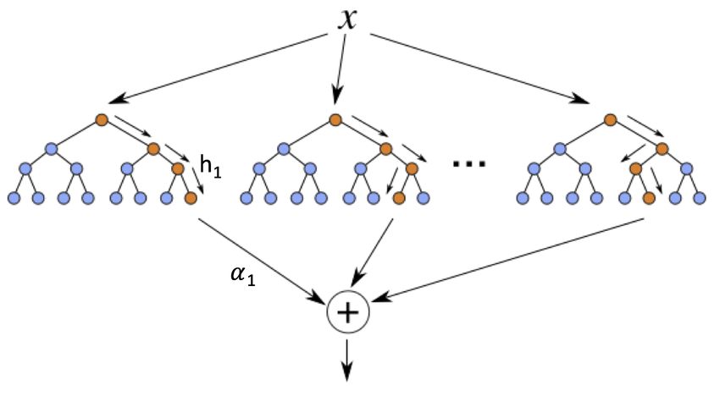
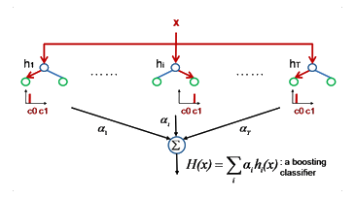
Machine Learning Model
Decision Tree
Random Forest
Boosting
11

Slide 12

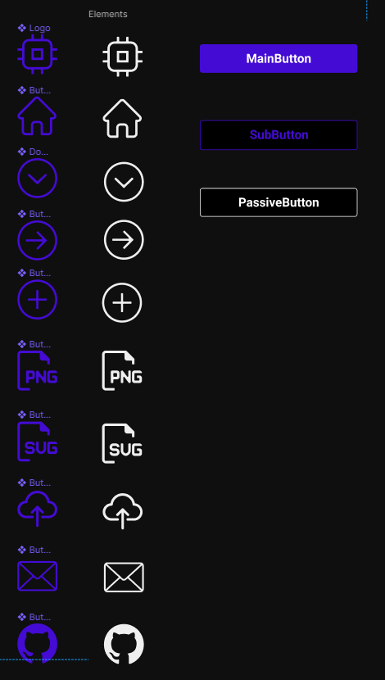

Site
Colors
Fonts
Elements
- Roboto
- Chonburi
Сетка
12

Slide 13
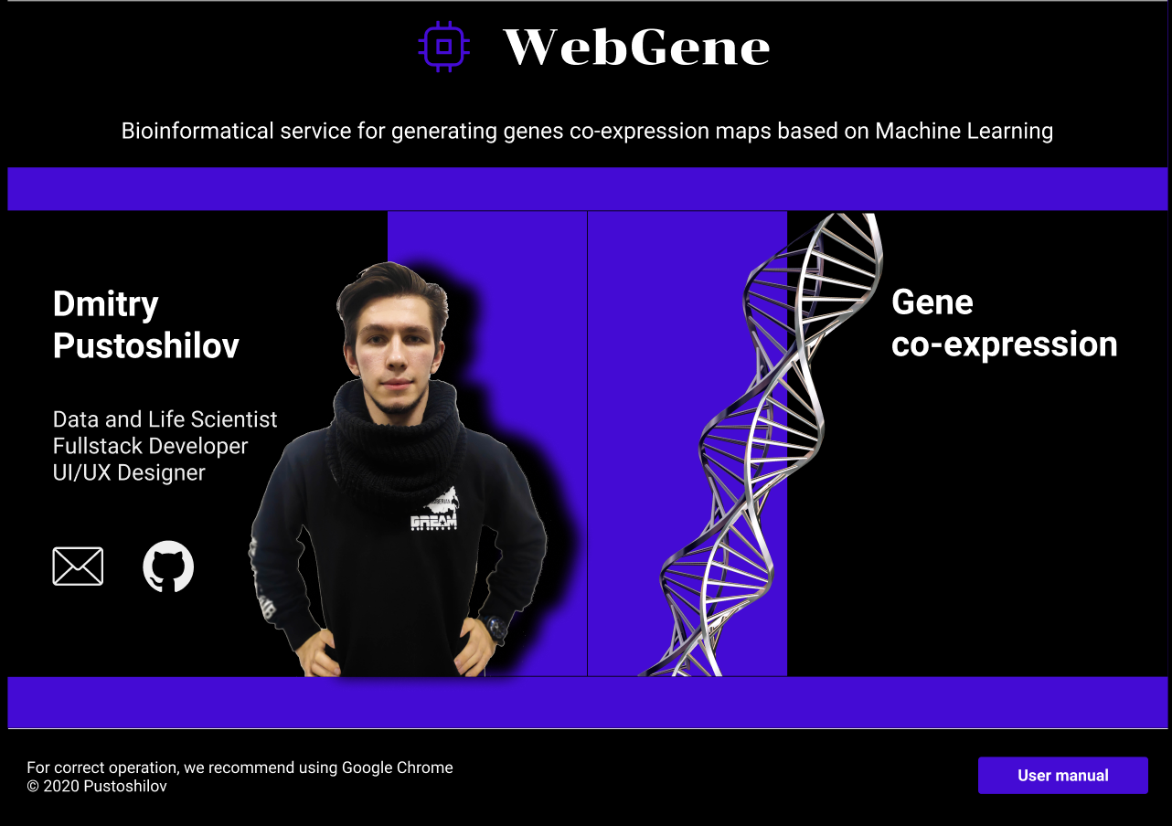
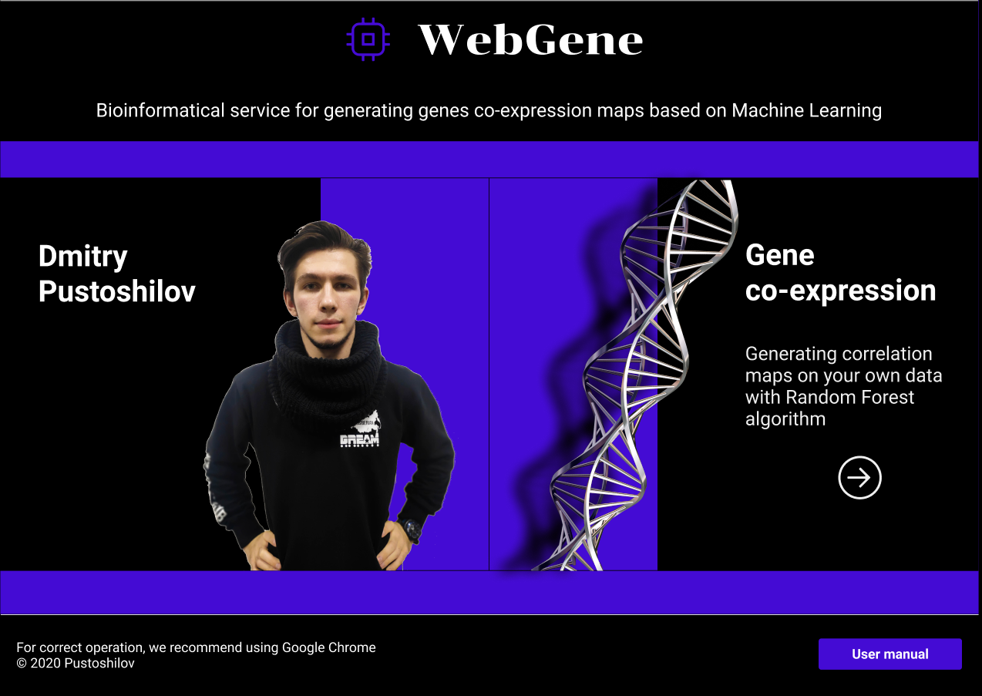
Site
Start page
13

Slide 14
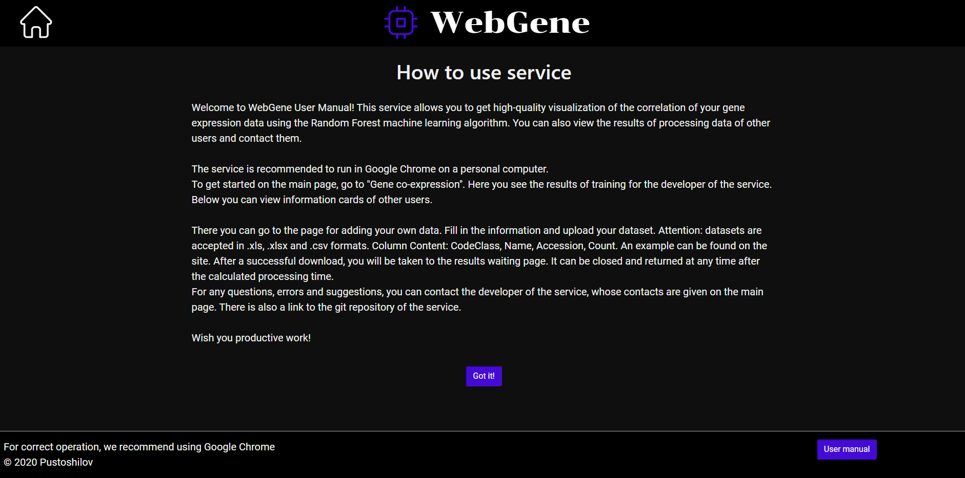
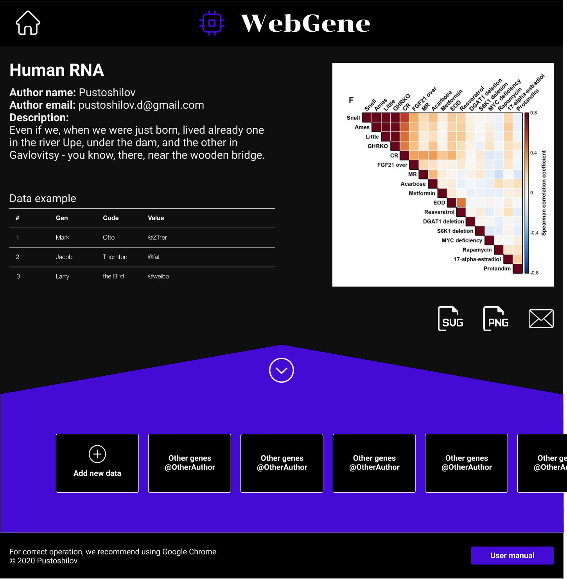
Site
User manual
Data card
14

Slide 15
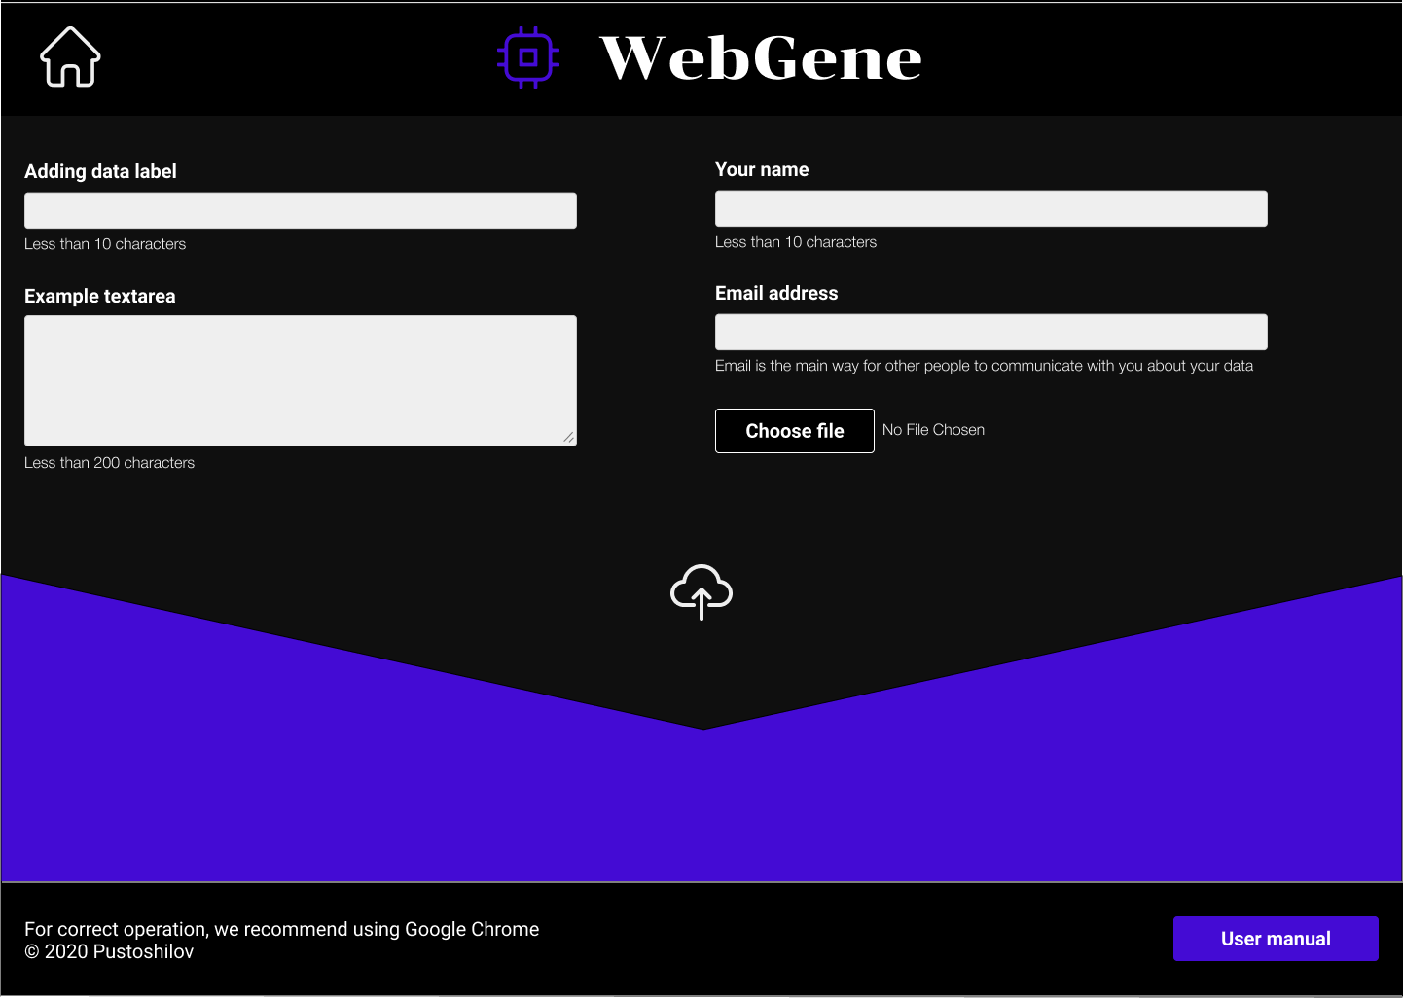
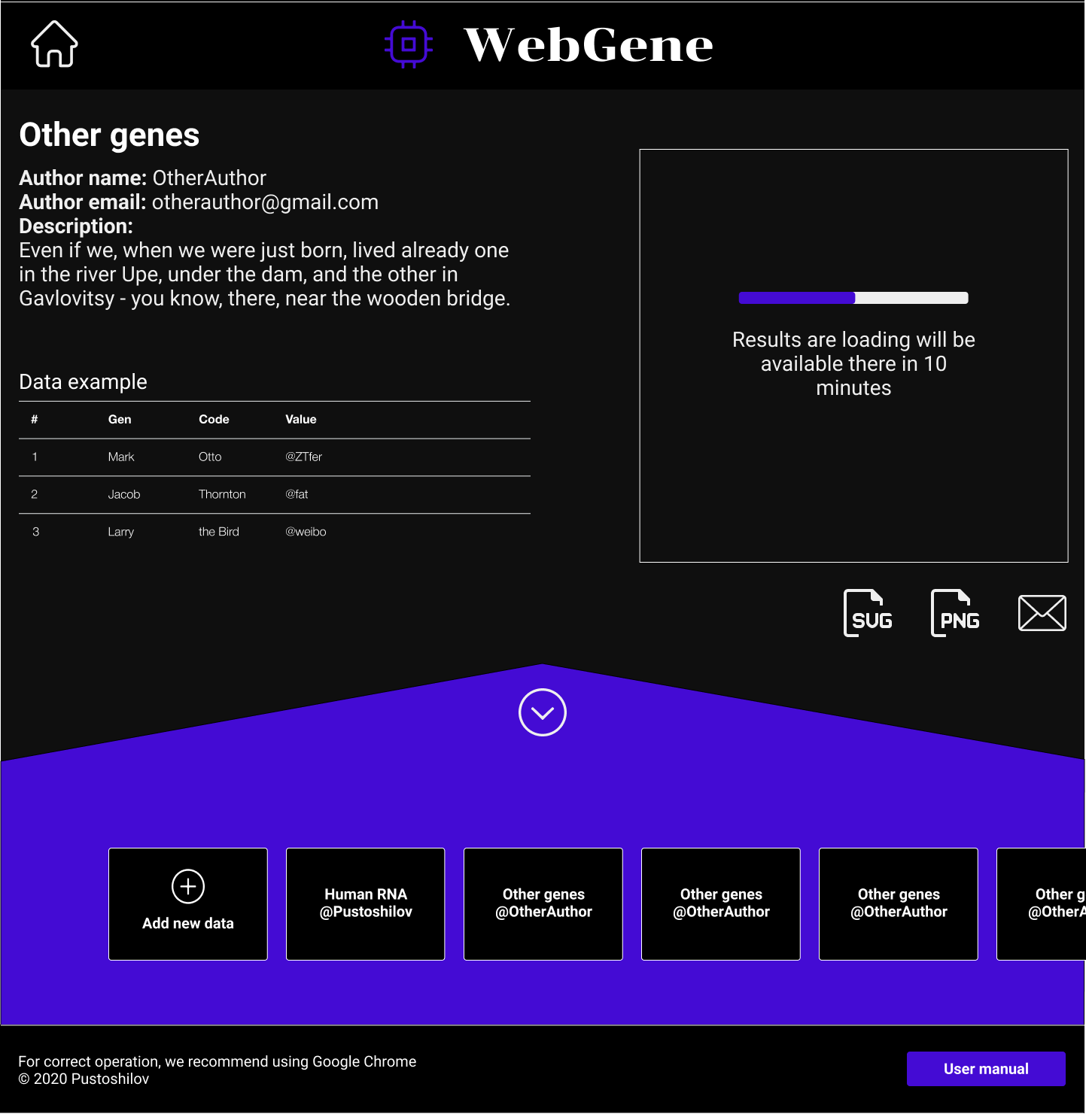
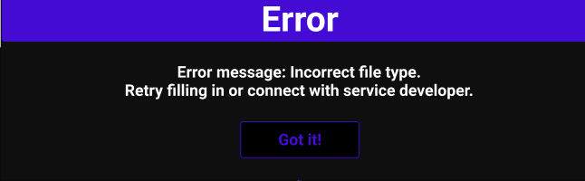
Site
Downloading new data
Data processing
Error message
15

Slide 16

Cloud Computing Functions
Functions:
postUserData:
Loading customer data
Data validation
Calculation of training time
Data preprocessing
Model training
Visualizing results
Saving in the database
getUserInfo:
Sending to the customer on request
16

Slide 17

Monetization
Integrated advertising
Paid features
Expanding functionality by order
Donations for the developer
Learning to create similar services
Grant support
17

Slide 18

Modernizing
In the first order:
UX and load testing,
Confirmation of the accuracy of the results
Separate site domain
Privacy policy and license
Error handlers in the server
Russian version of the site
Mobile adaptation
In the second:
Authorize and comment
Delete your details
Customize user data
18

Slide 19

Results significance
A convenient and accessible service for biologists
A platform for sharing research results
Educational material
Personal:
Packaging in production
Figma, React, Django and GCP
Immersion in the field of bioinformatics
Contribution to personal portfolio
Scientific article
19

Slide 20

Thank you for your attention!
Dmitry Pustoshilov
RTU MIREA, 2020
https://webgene.nw.r.appspot.com
https://github.com/pustoshilov-d
pustoshilov.d@gmail.com
20

